Slide 1

????Key word Spotting???
Students:
Ivancich Stefano
Masiero Luca
Supervisor:
Rossi Michele
22 September 2020

Slide 2
Outline
The Problem
The Solution
What we tried
Architecture 1: 1D CNN on RAW data
Architecture 2: DSConv on 80 Mels, 40 MFCC and 40MFCC+delta
Architecture 3: CNN+RNN+Attention
Performance comparison
… ??????????????????????????????????????
Conclusions
Ivancich S. - Masiero L.
22 September 2020
1

Slide 3
The Problem
Key word spotting:
Detect a relatively small set of predefined keywords (10 or 21) in a stream of user utterances.
Application: Mobile phone, smart home device, industrial machines.
Real Time
Metrics:
Accuracy
# of parameters
Prediction speed (milliseconds)
Ivancich S. - Masiero L.
22 September 2020
2

Slide 4
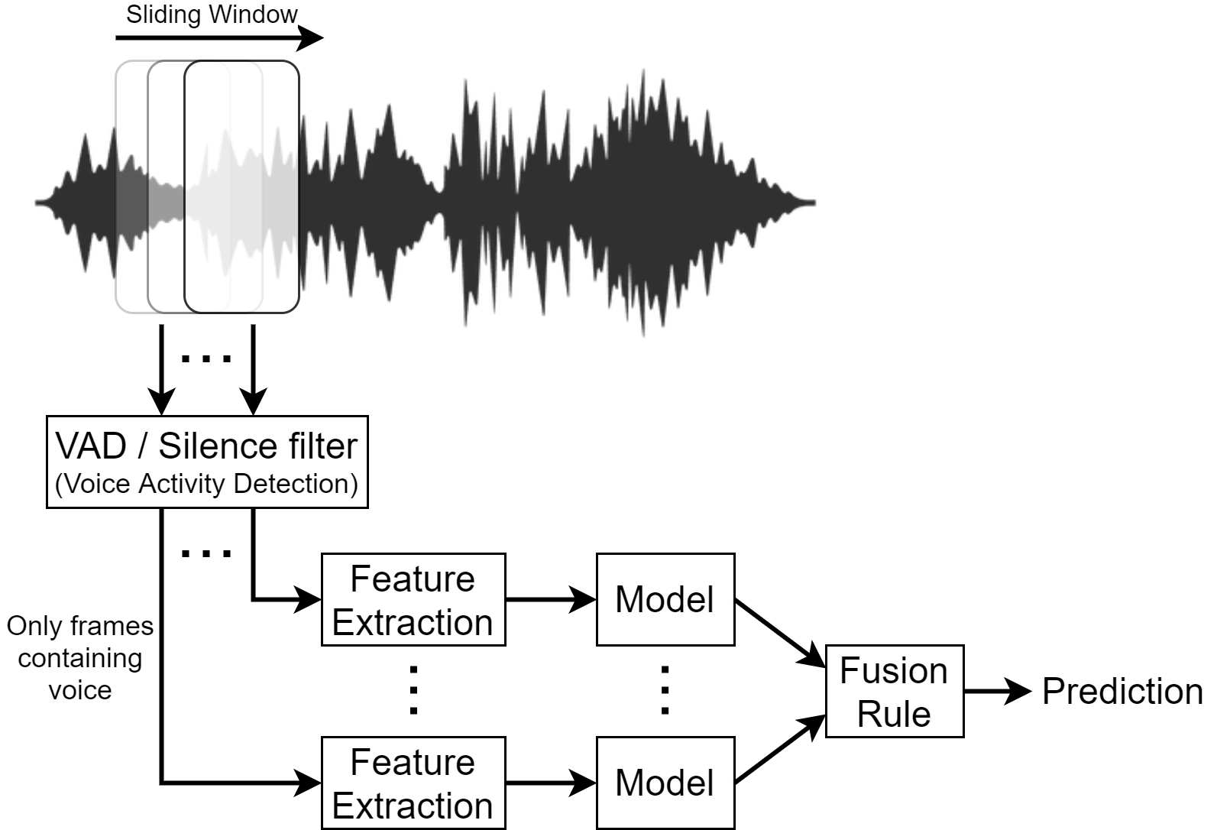
The Solution
Ivancich S. - Masiero L.
22 September 2020
2
Notes:
The input audio waveform X is split into S frames.
It is to computational expensive to use the model for each frame. So we can use a VAD (Voice Activity Detection) or Silence filter to let the model process just the frames that contains voice.
This component must be very compact, low computational expensive and very fast, like just ignoring anything under 40db, it can be a piece of software or even a little piece hardware like some home device are using.
We need to aggregate the CNN predictions to come up to a decision on X.
Fusion rules can be used to reach a ﬁnal decision, such as the majority vote

Slide 5
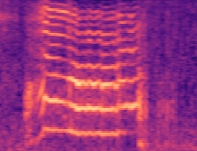
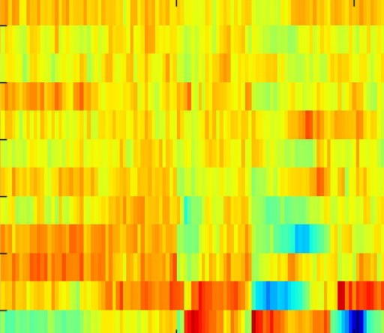
What we tried
Datasets:
10 commands (yes, no, up, down, left, right, on, off, stop, go)
21 commands (…, zero, one, two, three, four, five, six, seven, eight, nine, unknown)
Data Preprocessing techniques:
No preprocessing (Raw Waveform)
80 Mel spectrogram
40 MFCC
40 MFCC + 40delta + 40deltadelta (=120)
Learning Architectures:
1D CNN on RAW data
DSConv (Small-Medium-Large)
CNN + RNN +Attention
Ivancich S. – Masiero L.
22 September 2020
5

Slide 6
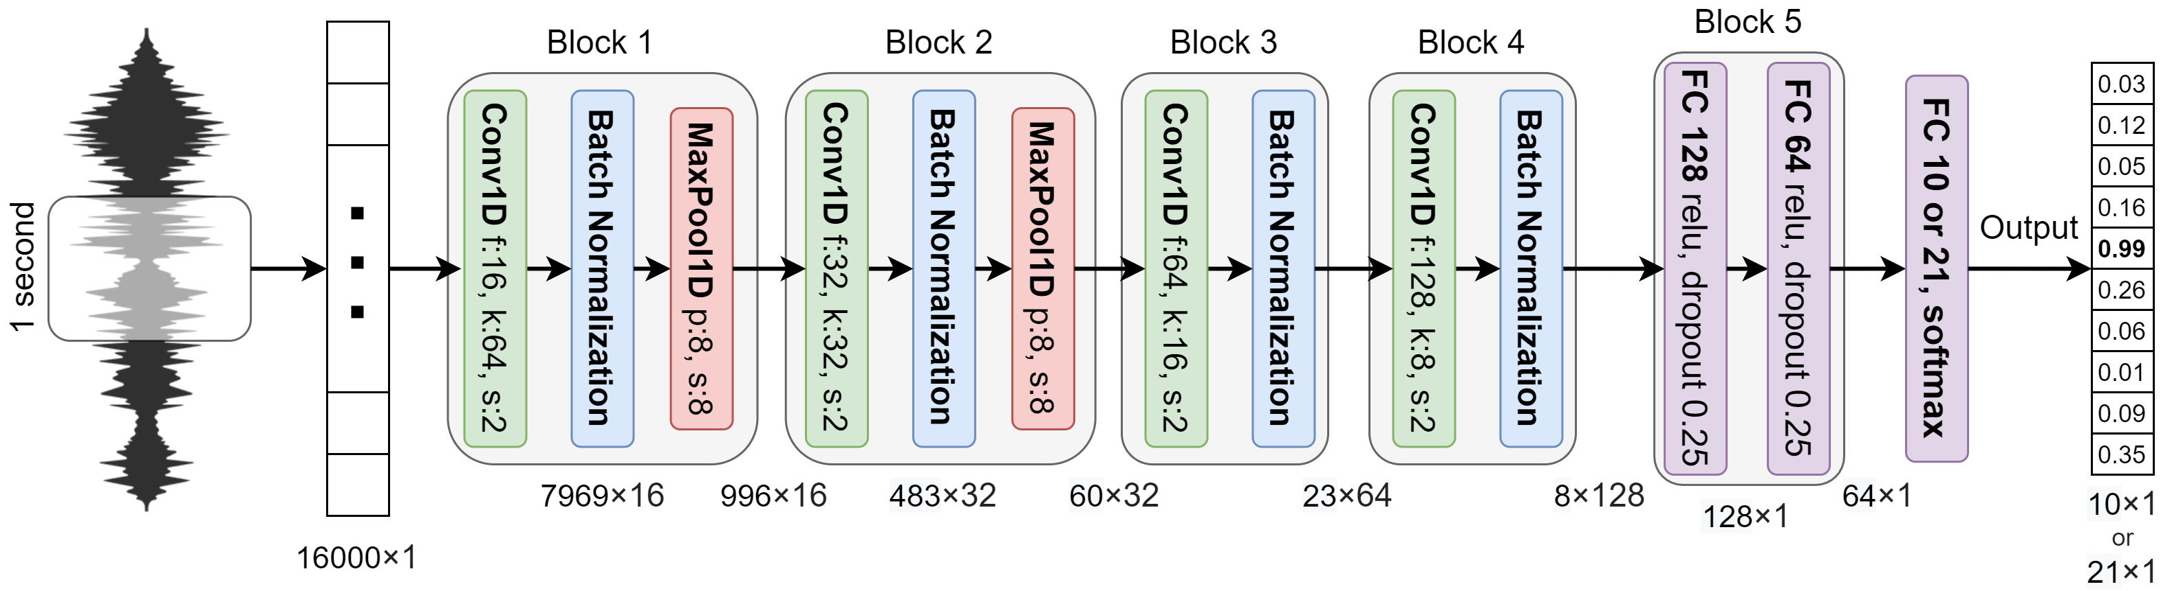
1D CNN on RAW data
 | 10 commands (30k - 3k - 3k) | 21 commands (84k - 9k - 11k)
Accuracy | 0,93
# parameters | 257,018
Pred. speed
Ivancich S. – Masiero L.
22 September 2020
5
Notes:
Input an array of 16,000 dimensions, which represents 1-second of audio sampled at 16kHz.
The architecture is composed of 4 convolutional layers, possibly interlaced with max pooling layers, followed by 2 fully connected layers and an output layer.
In order to reduce the over-fitting, batch normalization is applied after the activation function of each convolution layer.
after the last pooling layer, there are two fully connected layers with 128 and 64 neurons respectively on which a drop-out is applied with a probability of 0.25 for both layers.

Slide 7
1D CNN on RAW data
Ivancich S. – Masiero L.
22 September 2020
5

Slide 8
How we have tackled it
1) Literature from:
Teacher’s material
ArchiveX
paperswithcode.com
Reddit
GitHub
Paper’s references
2) For each paper:
What we find useful for our problem?
Which references we want to follow?
1D CNN
Attention
40 MFCC
DSConv
…
Ivancich S. - Masiero L.
20 July 2020
3

Slide 9

How we have tackled it
3) Try to mix from things written down
Example:
Paper X says that MFCC are good for human voice …
Paper Y says that DSConv are faster than normal CNN …
Mixing X and Y will work?
4 ) Debugging:
Bias vs Variance
Error Analysis: look at the misclassified examples
Why didn’t work? When explaining we discovered other things to try
40 MFCC
DSConv
Ivancich S. - Masiero L.
20 July 2020
4

Slide 10
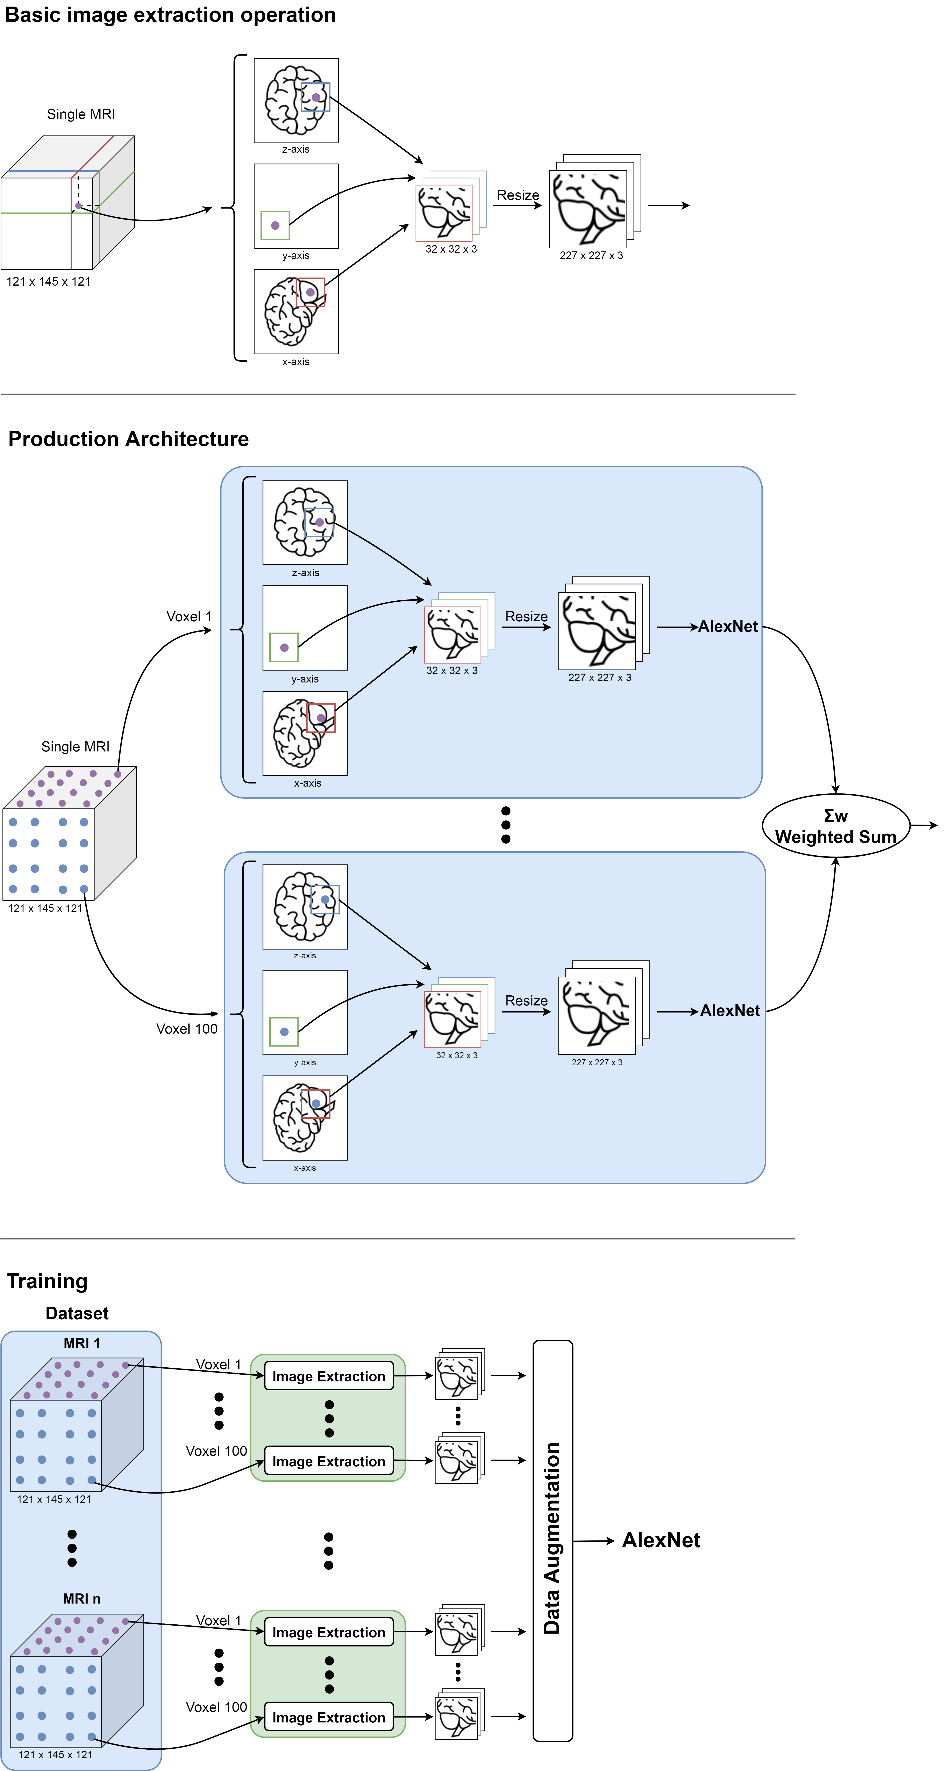
Image Extraction
MRI are 3D so to make them 2D we used the following image extraction operation: for a given voxel point, three patches of MRI 32x32 are extracted from the three planes, concatenated into a three-channel picture and resized in order to match the input size of the neural network.
Ivancich Stefano
15 July 2019
5

Slide 11
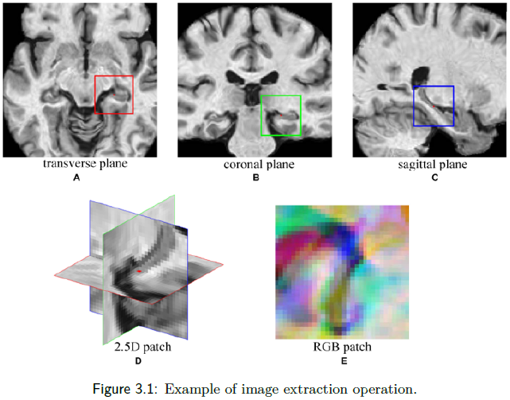
Example
Ivancich Stefano
15 July 2019
6

Slide 12
Production Architecture
Ivancich Stefano
15 July 2019
7

Slide 13
Training Architecture
Extract 100 pictures from each MRI
Perform some data augmentation
Fed them into AlexNet
Ivancich Stefano
15 July 2019
8

Slide 14
Architecture
A key challenge in applying CNNs is that sufficient training data are not always available in medical images. To avoid Over/Under-fitting:
Data Augmentation: In case of medical images this often comes down to mirror flipping, small-magnitude translations, weak Gaussian blurring, brightness augmentation and shadow augmentation.
TransferLearning from AlexNet: training CNN from scratch is usually challenging owing to the limited amount of labeled medical data. A promising alternative is to fine-tune the weights of a network that was trained using a large set of labeled natural images.
Prof. Tajbakhsh, Illinois Institute of Technology: considered several medical imaging applications and investigated how the performance of CNNs trained from scratch compared with the pre-trained CNNs. Their experiments demonstrated that pretrained CNNs performed better than CNN trained from scratch.
Ivancich Stefano
15 July 2019
9

Slide 15
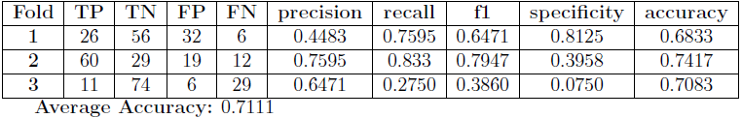
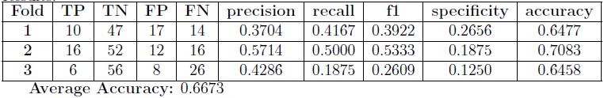
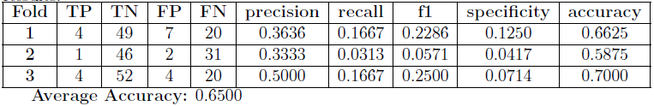
Performances
Due to the lack of memory (RAM) and computational power given to us, as we were undergraduate students: Instead of converting each MRI in 100 pictures, we have extracted only 8 pictures for each MRI, Trained on 3 folds instead of 20, haven’t performed any data augmentation. However, our supervisor will execute more exhaustive tests.
CN vs AD:
CN vs MCIc:
MCInc vs MCIc:
Ivancich Stefano
15 July 2019
10

Slide 16
Conclusions
Conclusions:
The tests showed that our model was very good at classify CN vs AD, that is an extraordinary results, because today to recognize if a person has Alzheimer different invasive medical tests must be done. With our model we need just a Magnetic Resonance.
Unfortunately CN vs MCIc and MCInc vs MCIc problems doesn’t reach good results, we think most of the problem is due to the lack of computational power.
Future Work:
Try different hyper-parameters during training
Change the structure of the network using:
pretrained VGG-19 or Inception v4
3D-Convolution
Ivancich Stefano
15 July 2019
11

Slide 17
Thank You
Thanks for your attention!
Any questions?
Ivancich S. - Masiero L.
20 July 2020
12

